Slide 1

||JAI SRI GURUDEV||
S J C INSTITUTE OF TECHNOLOGY
DEPARTMENT OF ELECTRONICS AND COMMUNICATION ENGINEERING
INTERNSHIP REVIEW
Image Processing and Antenna Design
Carried out at
DHRITVAN SPACE LAB
Presented by:
Annavajjala Niketh Sandilya -1SJ20EC010
INTERNAL GUIDE
Shreehari H S
Assistant Professor
Dept. of ECE, SJCIT
INTERNAL GUIDE
Anitha C
Assistant Professor
Dept. of ECE, SJCIT
INTERNSHIP COORDINATOR
Santhosh G
Assistant Professor
Dept. of ECE,SJCIT

Slide 2
OUTLINE
Company Profile
About Internship Field
About Internship Topic/S
Task Performed with Results
Advantages, Disadvantages
Applications
Reflection
Conclusion
References

Slide 3

DHRITVAN SPACE LAB
It is a ground station with the sole purpose of collecting real-time satellite image data and decoding it to produce a picture. This space lab primarily aids with technology comprehension and hands-on experience.

Slide 4
CONTENTS
Part A: Image Processing
1.What is Image Processing
2.Introduction to Software and some basic concepts.
3.Using of Single threshold value to create a mask.
4.Using of two threshold value to create a mask and its significance
5.Counting of Number of Balloons
Part B :Antenna Design
1.Basics of a Antenna and its dependency on its parameters.
2.Introduction to Software and a sample design.
3.Creating a microstrip path antenna for frequency of 33.5MHz.
4.Creating a MIMO antenna for frequency of 34MHz.
5.Creating a Circularly polarized antenna for frequency of 4.25GHz.

Slide 5
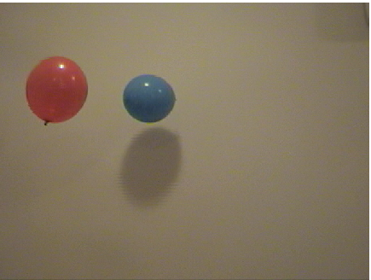
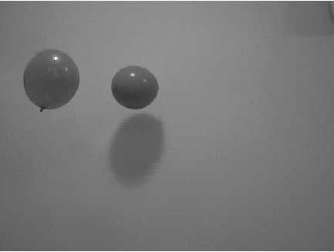
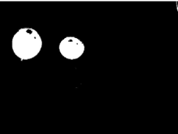
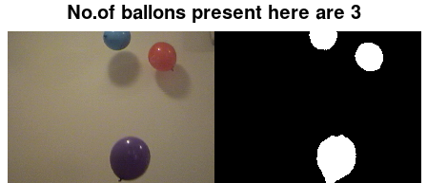
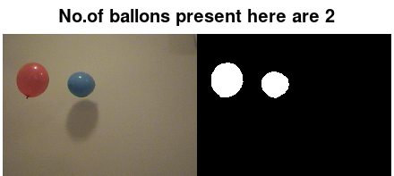
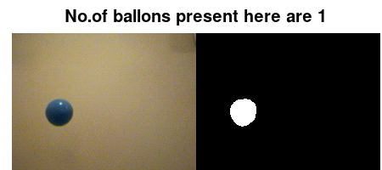
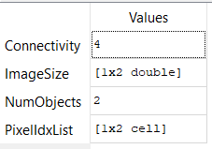
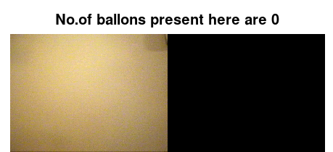
INTRODUCTION TO IMAGE PROCESSING
Pre-Processing
Segmentation
Feature
Extraction
Classification

Slide 6
TASK -1
With the use of a single threshold value that ranges from 0 to 255, make a mask for the image and assess its accuracy by comparing it to the ground truth. Find the image with the highest level of accuracy and its threshold.

Slide 7
SOLUTION
1. Take into account the range of 1 to 254.
2. By establishing a threshold value and contrasting it with the real data, or ground truth, accuracy can be attained.
3. The image's maximum level of precision will help determine its THRESHOLD value.

Slide 8
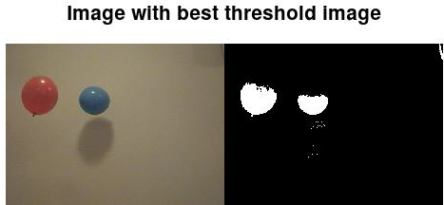
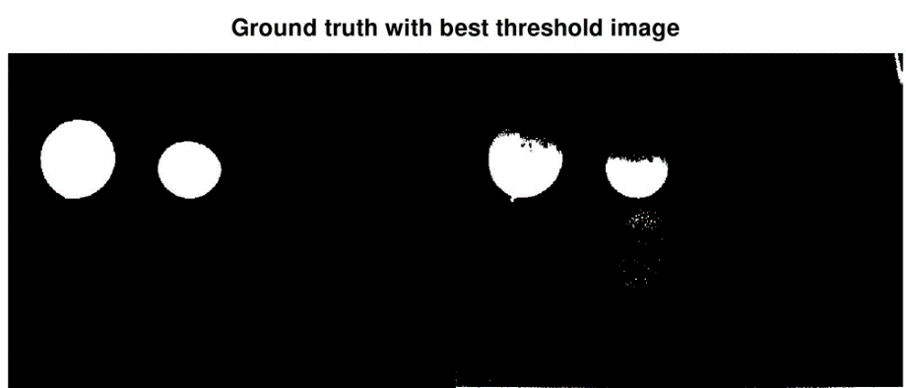
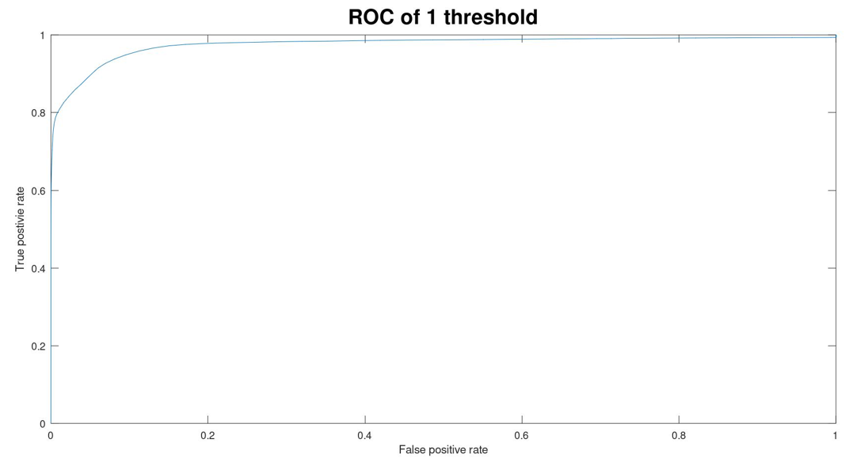

Slide 9
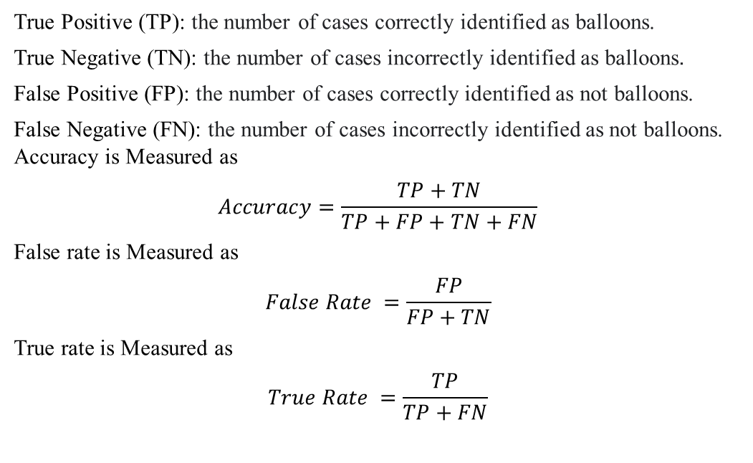
Process of calculating Accuracy by comparing with Ground truth
True Positive (TP): the number of cases correctly identified as balloons.
True Negative (TN): the number of cases incorrectly identified as balloons.
False Positive (FP): the number of cases correctly identified as not balloons.
False Negative (FN): the number of cases incorrectly identified as not balloons.
Accuracy is Measured as
$$Accuracy=\frac{TP+TN}{TP+FP+TN+FN}$$
False rate is Measured as
$$False Rate =\frac{FP}{FP+TN}$$
True rate is Measured as
$$True Rate =\frac{TP}{TP+FN}$$

Slide 10
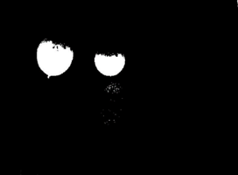
TASK 2
As utilizing a single threshold value results in inaccurate mask, we must utilize multiple threshold values, as an example, taking into account two thresholds by employing two planes, the RED and GREEN.
Single Threshold Binary image and observing of loss of accuracy
Single Threshold ROC and observing of loss of accuracy

Slide 11
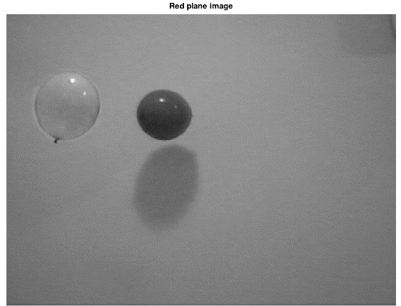
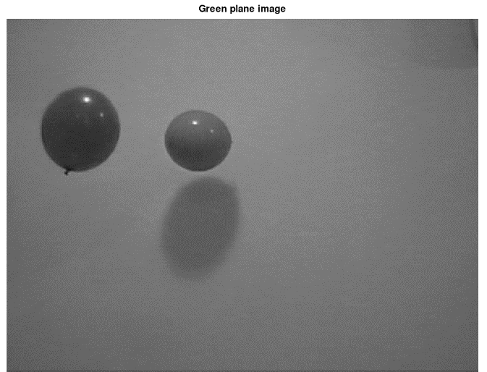
SOLUTION
The index of the image in both the red and green planes can be found using the accuracy approach while using the same threshold parameters. Comparing the Ground truth image reveals even this precision.

Slide 12
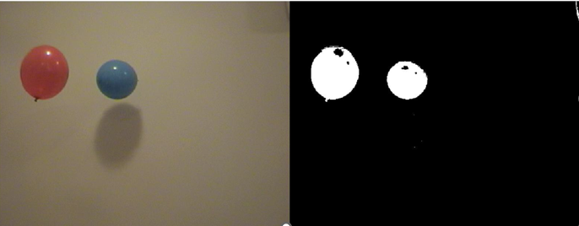
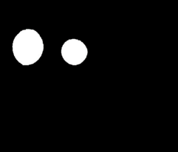
We can acquire the best mask that can be made by employing two planes by using the same way of constructing a mask by a single threshold that is applied for both planes.
Color Image
Threshold Image
Ground Truth

Slide 13
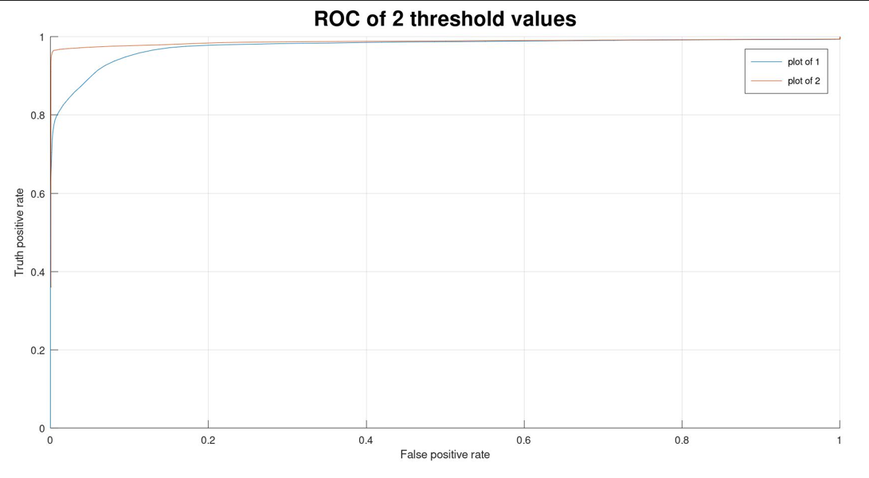
COMPARING SINGLE AND DOUBLE THRESHOLD
 | SINGLE THRESHOLD | DOUBLE THRESHOLD
Accuracy | 0.9851 | 0.9964
Index of Image | 91 | 93, 85
Compared to a single threshold mask, the mask has More
Accuracy.

Slide 14

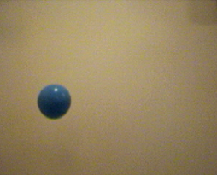
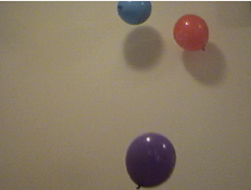
TASK 3
TASK 3
Count the number of balloons present in all the images in the data set of 51 images.
0 balloons
1 balloon
2 balloons
3 balloons

Slide 15
SOLUTION
1.The Object must now be classified by converting RGB into an HSV plane and attempting to determine which of three planes has the most categorization of the Object in the image.
2. Using morphological techniques to bring the image as near to the ground truth as possible.
3.Calculate the number of Area of interests.

Slide 16
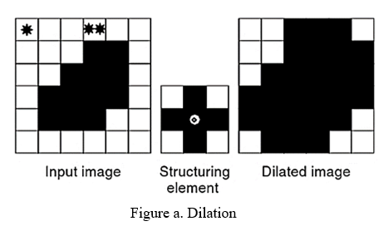
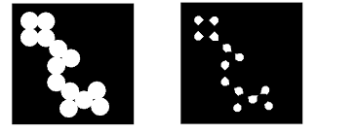
MORPHOLOGICAL OPERATIONS
Imdilate:
Imerode
Imopen:
Dilation followed by Erosion
Imclose:
Erosion followed by Dilation

Slide 17
RESULTS

Slide 19
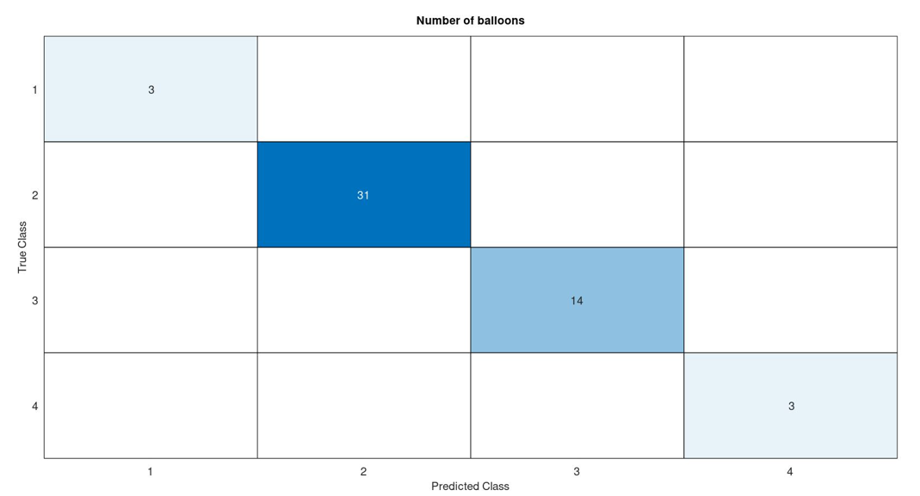
Confusion Matrix

Slide 20
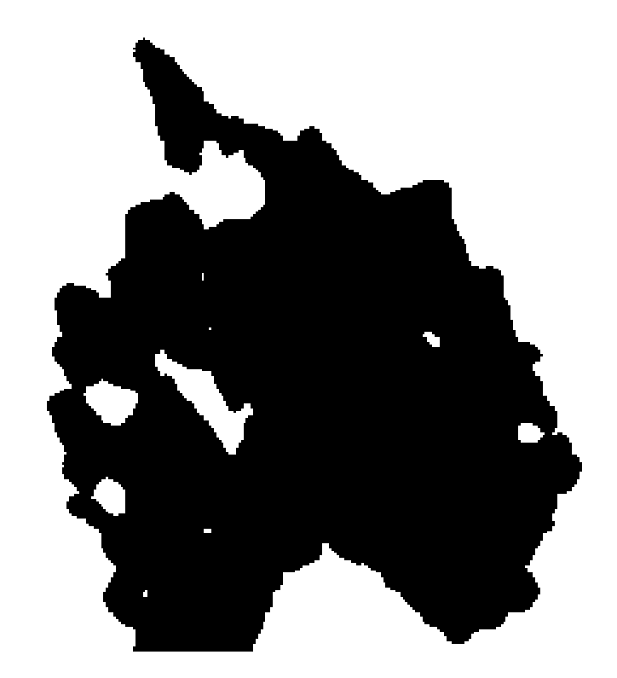
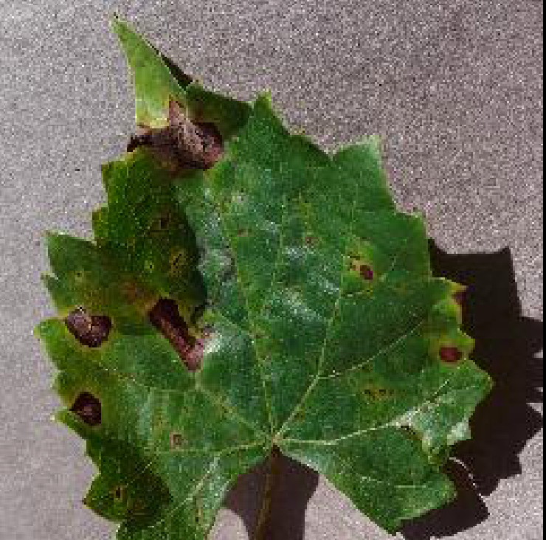

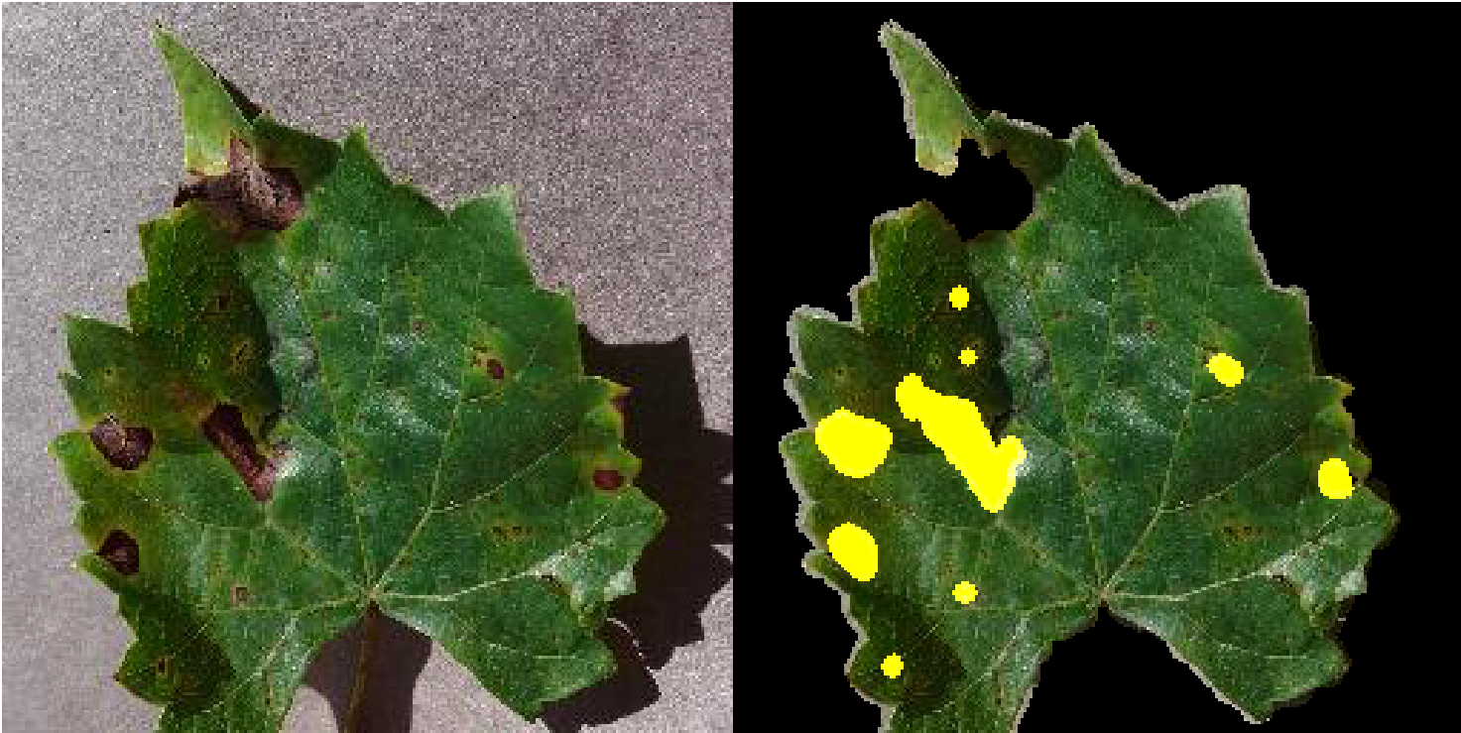
Real time application- Leaf segmentation
Diseased leaf Image
Mask is created of back ground and diseased part of leaf
Diseased part of leaf
Diseased part is colored as yellow

Slide 21
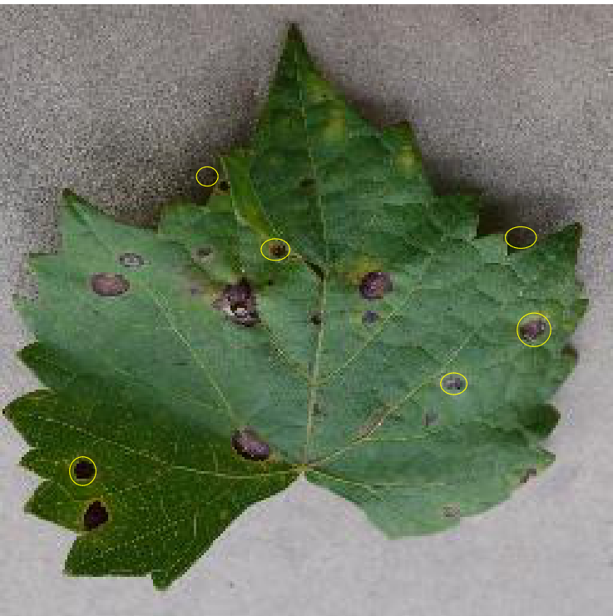
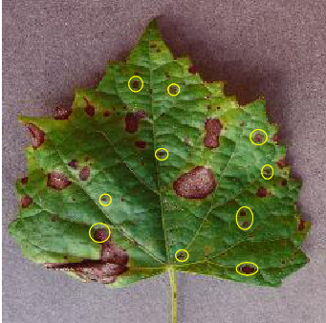
Leaf disease Part detections

Slide 22
ANTENNA DESIGN

Slide 23
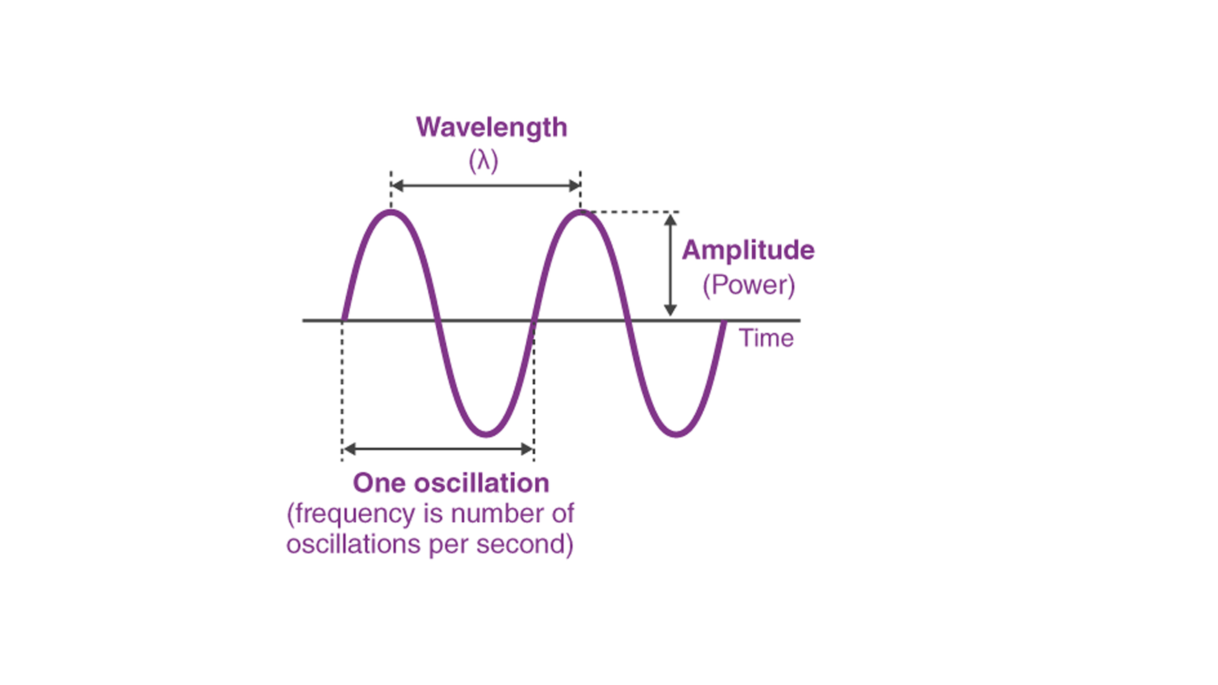
Antenna Design depends on various parameters
1.Frequency
2.Wavelength
3.Impedance matching
4.VSWR and Reflected Power
5.Bandwidth
6.Presentage Bandwidth
7.Radiation Intensity

Slide 24
Task-4
Creating a design of Microstrip Rectangular Patch Antenna in HFSS for operating frequency(f) of 33.5MHz , display all the resulting parameters.

Slide 25
Design Parameters | Description | Obtained values from Calculation(mm) | Optimized values for Performance(mm)
Wp | Width of patch | 3.386 | 3.62
Lp | Length of patch | 2.551 | 2.45
Wg | Width of substrate and ground plane | 5.49 | 6
Lg | Length of substrate and ground plane | 4.65 | 6
Wf | Width of feed line | 0.46 | 0.46
Lf | Length of feed line | 1.57 | 1.57

Slide 26
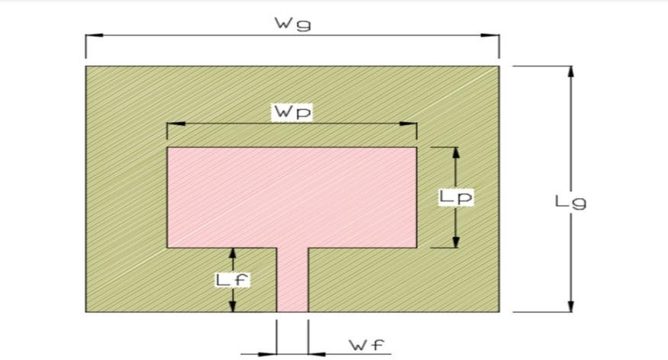
Antenna Structure

Slide 27
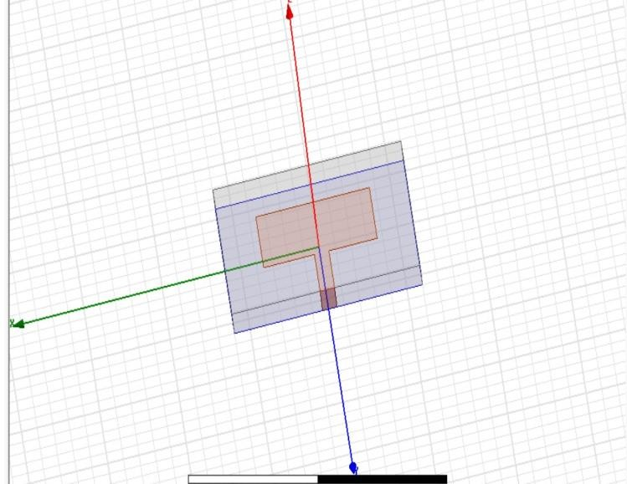
DESIGN IN HSFF

Slide 28
S-Parameter

Slide 29
Gain Plot

Slide 30
Task-5
Creating a design of MIMO microstrip patch antenna array design in HFSS for frequency(f) of 34MHz, display all the resulting parameters.

Slide 31
S.No | Design parameters | Description | Obtained values | Optimized values
1 | Wp | Width of patch | 3.386 | 3.62
2 | Lp | Length of patch | 2.551 | 2.45
3 | Wg | Width of substrate and ground plane | 5.49 | 6
4 | Lg | Length of substrate and ground plane | 4.65 | 6
5 | Wf | Width of feed line | 0.46 | 0.46
6 | Lf | Length of feed line | 1.57 | 1.57

Slide 32
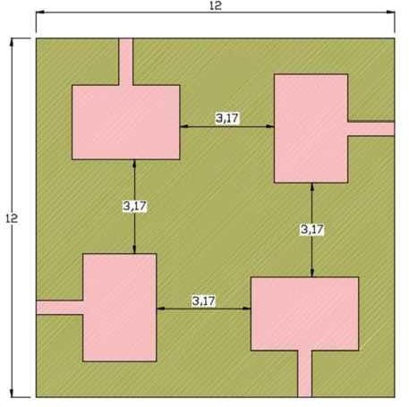
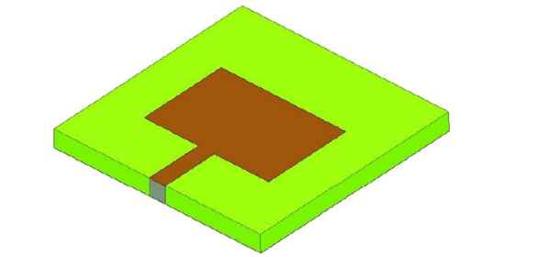
Antenna Structure

Slide 33
S-Parameter

Slide 34
Gain

Slide 35
Task-6
Creating a design of Circularly polarized parasitic strips for frequency(f) for 4.25GHz in HFSS, display all the resulting parameter.

Slide 36
Parameters | Values | Parameters | Values
L1 | 17.8 | L9 | 6
L2 | 23 | Ls | 55
L3 | 4.5 | W | 3
L4 | 17 | W1 | 2
L5 | 9 | Ws | 50
L6 | 17.8 | Wg | 20
L7 | 6 | D | 1
L8 & Wf | 26 & 0.7 | H | 0.8

Slide 37
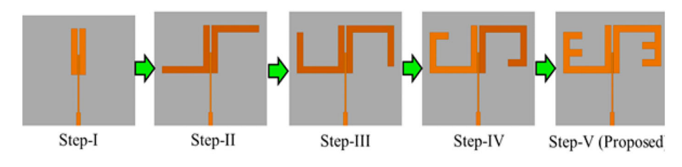
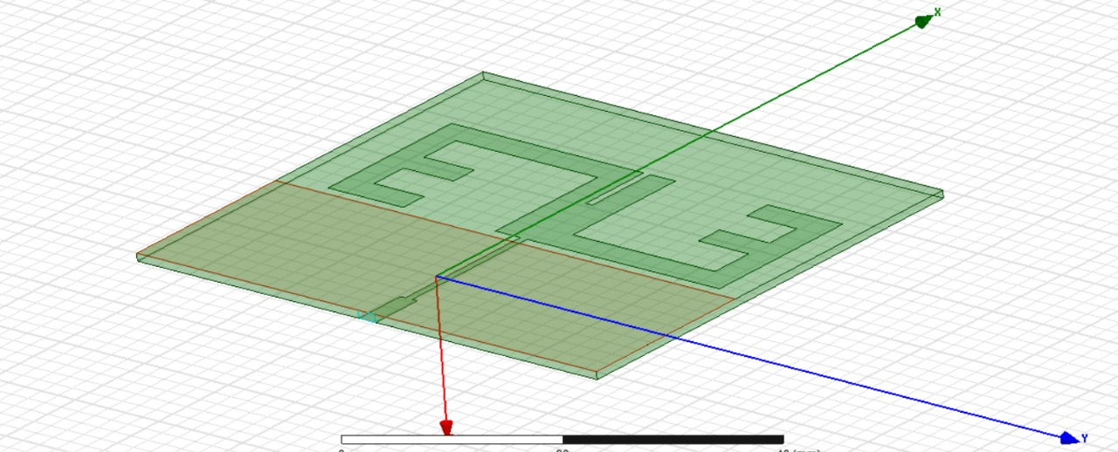
Steps to be followed and Antenna Structure

Slide 38
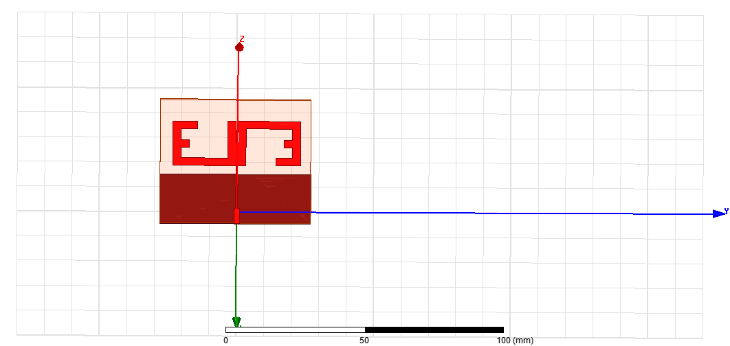
DESIGN IN HSFF

Slide 39
S-Parameter

Slide 40
Gain Parameter

Slide 41
Electrical Field
Magnetic Field

Slide 42
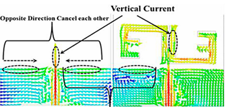
TRANSMISSION MOVEMENT

Slide 43
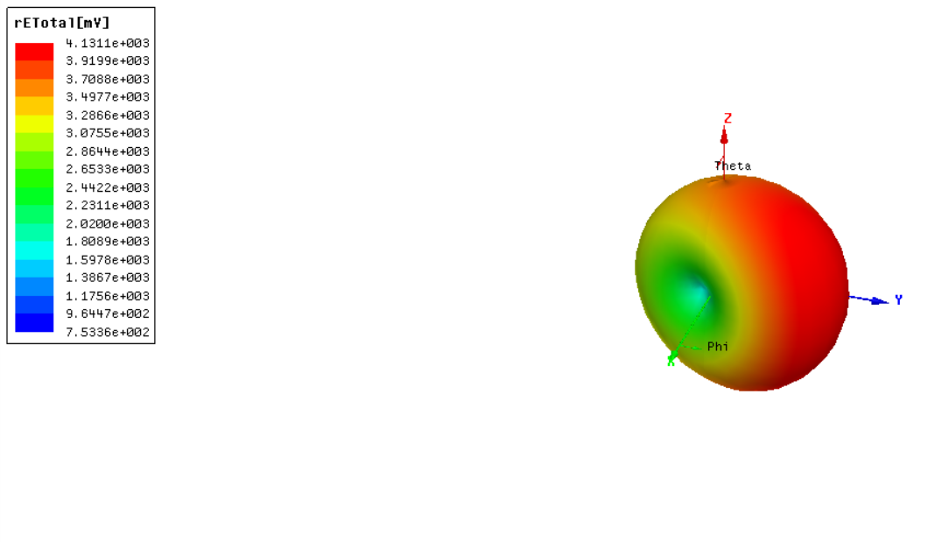
Radiation in 3-D

Slide 44
REFERENCES
[1] MATLAB documentation. https://in.mathworks.com/help/images
[2] GNU Octave (version 8.3.0) documentation https://docs.octave.org/latest
[3] https://www.researchgate.net/publication/271770488_A_Review_on_Image_Processing
[4] https://jivp-eurasipjournals.springeropen.com/articles/10.1186/s13640-018-0383-6
[5] https://www.viva-technology.org/New/IJRI/2018/10.pdf
[6] https://www.simplilearn.com/image-processing-article
[7] https://www.v7labs.com/blog/image-processing-guide
[8] https://doi.org/10.1007/s11042-023-14628-2
[9] https://doi.org/10.1080/03772063.2023.2183905

Slide 45
CONCLUSION
Image processing is a versatile field with a wide range of applications and goals, making it a crucial component of various industries and technologies. One prominent application is in the field of medical imaging, where image processing techniques are used to enhance and analyse medical images, aiding in the diagnosis and treatment of diseases.
Antenna Design is a great field for exploration of different design parameter for different frequencies, And with has so many applications in wireless communication.

Slide 46


